Slide 1

Closest Pair of Points using Divide and Conquer Algorithm
name: Menna Mohamad albanna
Id: 222745

Slide 2
Divide and Conquer Algorithm
It is considered an effective way to solve most problems, and we certainly use it in our daily lives without thinking.
>> Let's give a small example:
when we need to look for something that we’ve lost around the house. Instead of trying to search the entire house,
we can subdivide the problem into smaller parts by looking in each room separately.
Then, within each room, we can even further subdivide the problem by looking at each piece of furniture individually.
By reducing the problem’s size and complexity, it becomes easier to search through each individual piece of furniture in the house, either finding our lost object or eliminating that area as the likely location it will be found.

Slide 3
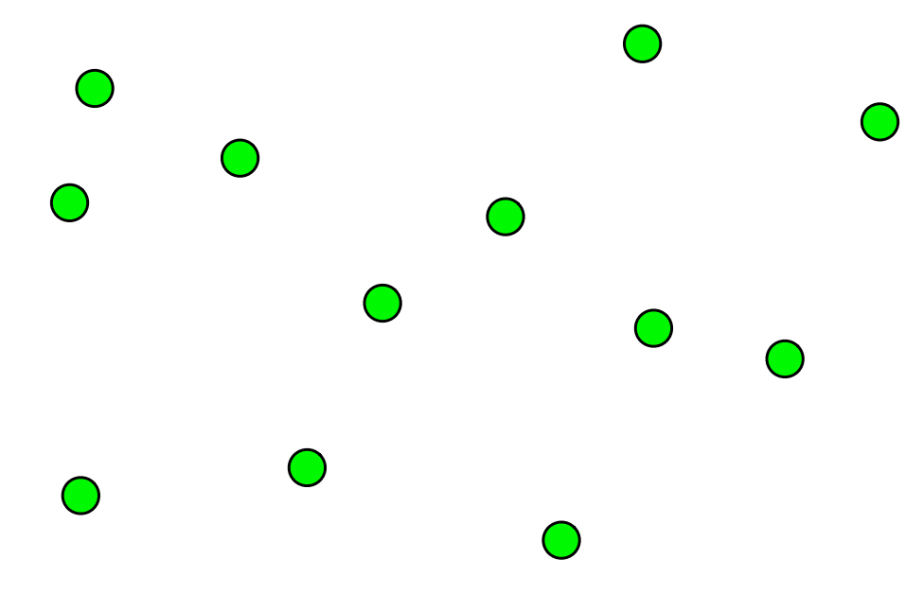
Closest Pair problem:
Problem: Given a set of n points in 2D space,
find the pair of points with the minimum distance between them.
Some ways to solve the problem:
Brute-force O(n^2) time complexity.
This means that there is a need for a more effective
algorithm, and here Divide and Conquer algorithm
is more effective
Let's explain:

Slide 4
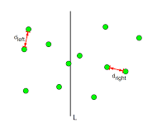
Closest Pair (Divide and Conquer)
Main steps :
Divide: Divide the set of points into two halves recursively.
Conquer: Find the closest pair in
each half recursively (d).
3.Combine: Merge the two halves and
find the closest pair across the split.
Let’s discuss more details:

Slide 5
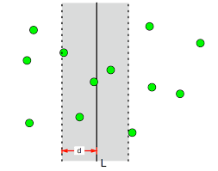
After that you should limit your searching area:
Create a strip of width 2d centered
around the dividing line.
Consider only the points within the strip.
Sort these points by their y-coordinates.
For each point in the strip, compare its
distance to its neighbors
(in the range of strip).
Update the minimum distance if a closer pair is found.

Slide 6

>> For example, we will take a specific point to compare it to the rest of the area around it
But are we going to compare all the points of
the strip?
of course not , let me explain :
The search operation will be limited to points that
are less than d away from the taken point.
So, We must specify the search area that meets this condition,
let us do the following:
Defines a rectangle with dimensions d and 2d
within the specified area around the point to be compared

Slide 7


Compare the points inside this rectangle with each
other only,
so that the points have been
verified to meet the condition.
“Some people may ask another question”:
While it is not possible to know a specific number of points
within the rectangle, which results in an indefinite number
of comparisons,
how can we have found a solution to the problem with
other algorithmic methods?
2 d
d

Slide 8

I can easily answer this question:
>>The number of points within the same rectangle can
only be a very limited number,
meaning that the possibility of there being a crowding of points and repeating
the comparison with a large number is non-existent.
Because it will simply be considered a contradiction,
when the points are crowded inside the rectangle,
this indicates that they are located at distances smaller than
the dimensions of the rectangle, that is, smaller than D.
So, how can there be two points with a distance less than
d and not be classified as the closest pair from the beginning?
Impossible case

Slide 9
Python code
ClosestPairDivideAndConquer(points):
if len(points) <= 3:
return ClosestPairBruteForce(points)
mid = len(points) // 2
leftPoints = points[:mid]
rightPoints = points[mid:]
leftMinDistance, leftClosestPair = ClosestPairDivideAndConquer(leftPoints)
rightMinDistance, rightClosestPair = ClosestPairDivideAndConquer(rightPoints)
minDistance = min(leftMinDistance, rightMinDistance)
closestPair = None
if minDistance == leftMinDistance:
closestPair = leftClosestPair
else:
closestPair = rightClosestPair
midStrip = []
for point in points:
if abs(point[0] - points[mid][0]) < minDistance:
midStrip.append(point)
stripMinDistance, stripClosestPair = ClosestPairStrip(midStrip, minDistance)
if stripMinDistance < minDistance:
minDistance = stripMinDistance
closestPair = stripClosestPair
return minDistance, closestPair

Slide 10
The divide-and-conquer algorithm efficiently
using Master Theorem.
Let T(n) denote the time complexity for solving a problem of size n
Sort the points by their x-coordinates (O(n log n)). Divide the sorted points into two equal halves (O(n)).
O(n log n) + O(n) = O(n log n)
Recursively find the closest pair in each half
(2 * T(n/2)).
Consider only points within the strip (O(n)).
Sort these points by their y-coordinates (O(n log n)).
Compare each point to its closest neighbors (O(n)).
Update the minimum distance if a closer pair is found.
O(n) + O(n log n) + O(n) = O(n log n)
Total:
T(n) = 2T(n/2) + O(n log n)
Applying the Master Theorem :
A=2, b=2 , b^d=2 → a=b^d
T(n)=> n^d log n
=> T(n) = θ(n log n)
Therefore, the closest pair divide-and-conquer algorithm has a time complexity of O(n log n),
which is significantly faster than the brute-force approach with a complexity of O(n^2).

Slide 11
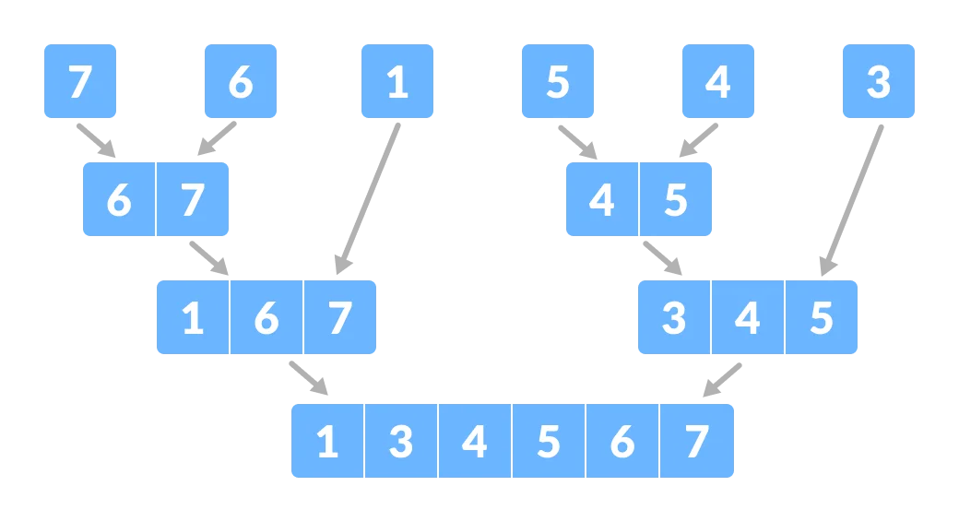
T
h
a
n
k
s
T
h
n
k
T
h
a
n
k
s
T
h
a
n
k
s

